Slide 1
Better Password Generator
Shreya, Alan, Alex, Ben

Slide 2
Background - What makes a good password?
Humans are not very good at evaluating what good passwords are (Ur et. al)
punk4life vs punkforlife
astley123 vs astleyabc
pAsswOrd vs p@ssw0rd
ieatkale188 vs iloveyou88
Keyboard Patterns (i.e. 1qaz2wdc3edc, qwertyuiop)
Correctly identify adding symbols, adding obscure words add security
Badness (Gehringer)
Contain dictionary words
Be the name of a friend, relative, or a famous person
Be less than 8 characters in length
End with, start with or contain a predictable sequence of letters like 123
Notes:
Alan

Slide 3
Background - What makes a good password?
Humans are not very good at evaluating what good passwords are (Ur et. al)
punk4life vs punkforlife
astley123 vs astleyabc
pAsswOrd vs p@ssw0rd
ieatkale188 vs iloveyou88
Keyboard Patterns (i.e. 1qaz2wdc3edc, qwertyuiop)
Correctly identify adding symbols, adding obscure words add security
Badness (Gehringer)
Contain dictionary words
Be the name of a friend, relative, or a famous person
Be less than 8 characters in length
End with, start with or contain a predictable sequence of letters like 123

Slide 4
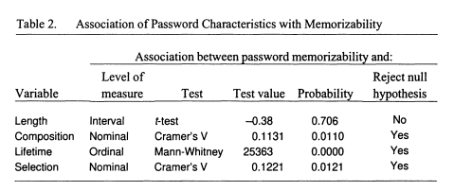
Background - Memorability of Passwords
composition (letters vs numeric)
lifetime (how often the password is changed)
selection (how the password is generated)
Length has no significant effect on memorability
Average password length is only 6!
Notes:
Alan?

Slide 5
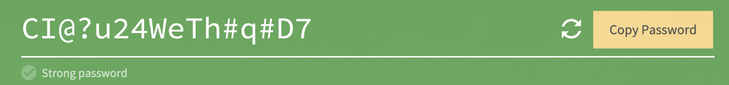
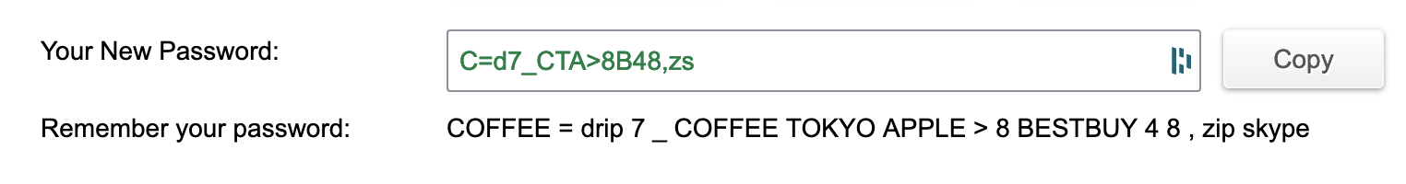
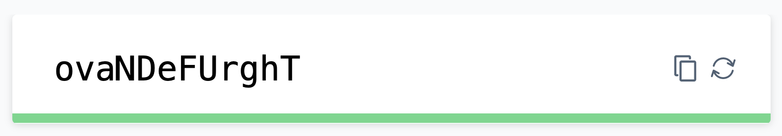
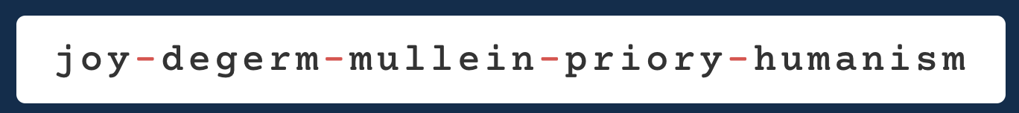
Background - Existing password generators
Notes:
Alex
https://my.norton.com/extspa/passwordmanager?path=pwd-gen
https://passwordsgenerator.net/: supposed to help remember your password?
https://www.lastpass.com/features/password-generator: “easy to say”
https://1password.com/password-generator/: “5 random words”

Slide 6
Background - Security threats
Existing adversarial attacks
Brute force attack
Dictionary attack
Phishing
Credential stuffing
Lazy users
Reuse passwords
Low entropy passwords
Do not understand basic password security
Insecure use higher-entropy passwords
Require low-effort security tools
Notes:
Ben
Credential stuffing: using previously stolen credentials from another source

Slide 7
Survey Results
Focus: password generation, use, and reasoning for suboptimal password hygiene
70% of users do not use a password generator
¾ of users change passwords only when required
Users have some password variety, but not one per-account
Cited reasons for not using a generator: effort, memorability
Cited reasons for not using large variety: memorability
Notes:
Ben

Slide 8
Implementation
We came to the conclusion that the best generated passwords would be ones that use a mnemonic or a decently memorable sentence.
This sentence can later be manipulated to generate the actual password and make it more robust to attacks
We used GPT-2 to generate these sentences!
Notes:
Shreya

Slide 9
GPT-2
GPT-2, a language model, has the capability to generate sentences of various forms. These sentences can be meaningful or meaningless, depending on the parameters fed into the model, specifically, ‘temperature’ and ‘top_k’
Temperature relates to the Boltzmann distribution - higher temperature means more random, as temperature approaches 0, deterministic and repetitive
top_k is the number of words considered for every step - 1 would mean deterministic
We set these parameters such that the generated sentences were not meaningful, but still coherent in a memorable way
Examples of generated sentences:
'todos', 'rarities', 'which', 'find', 'searching', 'that'
'wasp', 'story', 'bizarre', 'serenity', 'that', 'this'
Notes:
Shreya

Slide 10
Creating the password from the Generated Sentence
Example: Sentence: “Hello this days shall funny neither ...”, Random Positions: (1, 3)
Result password: “elhsashlunet”
STEPS:
Get the first 6 words of the sentence
Get the letters at the specified random positions in each word(0 indexed)
String together the letters obtained to get the password
RESULT: A 12 letter password which is decently unpredictable and memorable
Notes:
Shreya

Slide 11
Specifications
We decided to only include small letters(a-z) in our sentences and hence our passwords as a default.
All words in the sentences are more than 3 letters
For the random positions, the first position is restricted to 1-3, and if the last position overflows, the user is instructed to use the last letter of the word
Notes:
Shreya

Slide 12
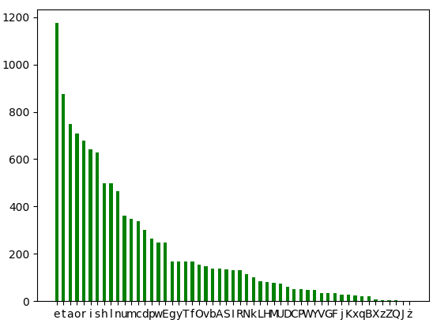
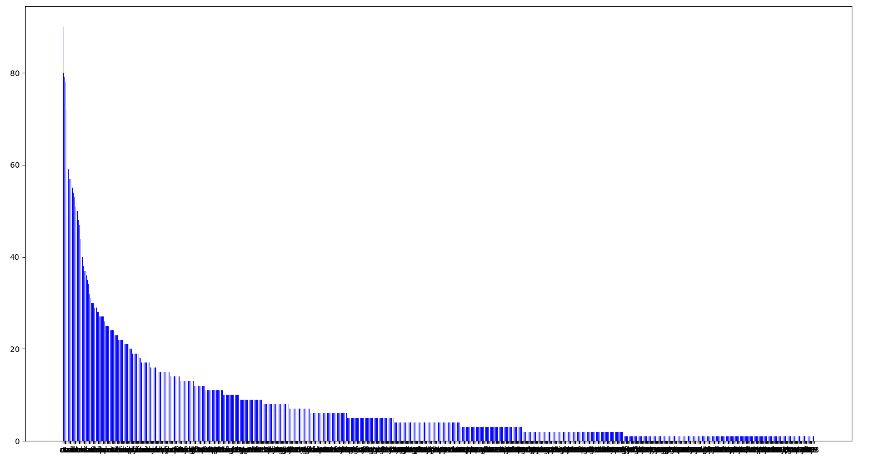
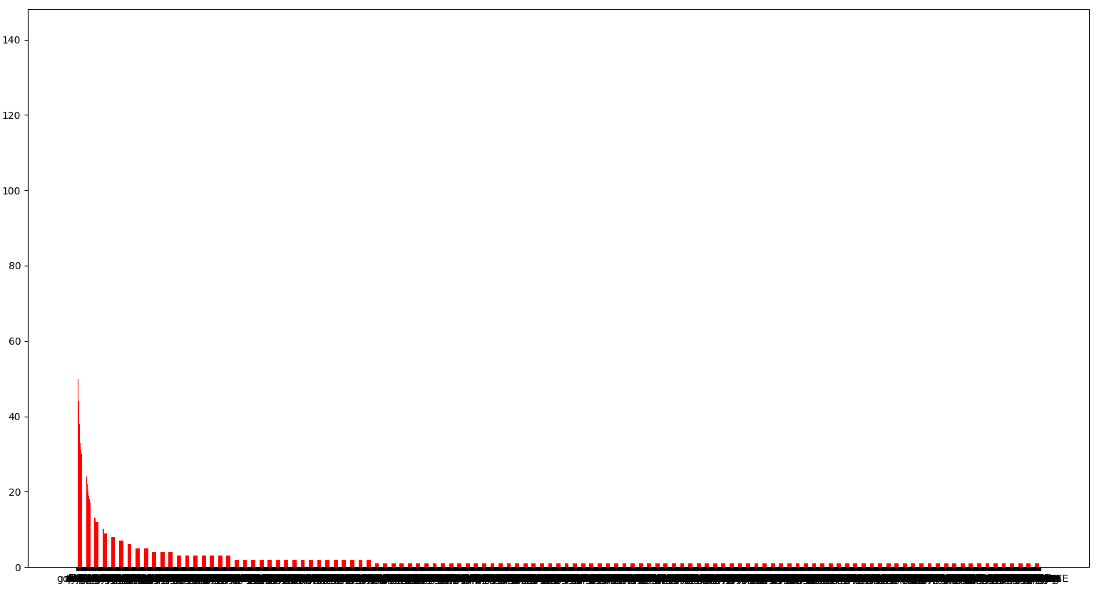
Notes:
Alan?

Slide 13
Potential refinements to the Generator
Inject symbols, numbers, padding to increase size of character set
Example: Randomly generated digit: 4, Positions to add digit: Before words 1, 3, 2, 5 (has been added to the current model as a parameter)
Capitalization of entire words in the sentence to introduce capital letters in the password (has been added to the current model as a parameter)
Adjust temperature and top_k values
Notes:
Shreya

Slide 14
Analysis
Entropy:
Without numbers or capitalizations: ~2^56
With just numbers: ~2^81
With just capitalization: ~2^68
With both numbers and capitalization: ~2^93
With numbers, capitalization, only most frequent 10 letters: ~2^73
Entropy should protect against common attacks
Entropy of GPT-2 model itself still unclear
Notes:
Ben

Slide 15
Questions?

